Slide 1




Slide 2





WebXR Demo Code Development
(20 mins.)
Wei Chung Chuo
Lead Developer Technical Engineering Solution
Futurewei Technologies, Inc.
Notes:
Note: This is a 20 minutes code demo presentation.

Slide 3
Agenda
About Wonderland Engine and main features
Download and install Wonderland Engine, Visual Studio Code, Wolvic
Wonderland Engine overview
Getting started: create a new VR project, import, delete and modify objects
Apply JavaScript components to objects
Modify scene view, lighting, and enabling shadows
Game goal and design, JavaScript game components
Apply JavaScript logic to the scene:
Mouse spawner
Projectile spawner
Projectile trajectory control
Collision detection and scoring
Sfx, music
View and debug in Huawei VR Glass
Rendering Simplified Chinese characters
Demo codes and websites
Notes:
Hello everyone! My name is Wei Chung from Futurewei Technologies.
Today we’re going to go over what the Wonderland Engine is, its main features, and how to build your own VR experience using the Wonderland Engine. From this video, you will learn:
How to setup your development environment.
The different parts of the Wonderland Editor UI
Getting started with a new VR project and adding in objects
Applying JavaScript components to your objects
How to change the camera view, the scene lighting, and enabling casted shadows.
Then we’ll get into the design goals of our specific demo and its JavaScript game components
How to debug a game from the Huawei VR glass
And lastly, rendering support for Simplified Chinese characters

Slide 4

About
Wonderland Engine is a development platform for web-based graphics applications. It comes with an accessible 3D editor application – the Wonderland Editor – and an efficient WebAssembly-based runtime that runs in the browser.
Wonderland Engine enables you to easily build highly performant graphics applications for the web.
Notes:
The Wonderland Engine is a development platform for web-based graphics applications, specifically for VR and AR.
It comes with an accessible 3D editor application, the Wonderland Editor, and an efficient WebAssembly runtime that runs in the browser.
The Wonderland Engine enables you to easily build highly performant VR and AR applications for the web.

Slide 5
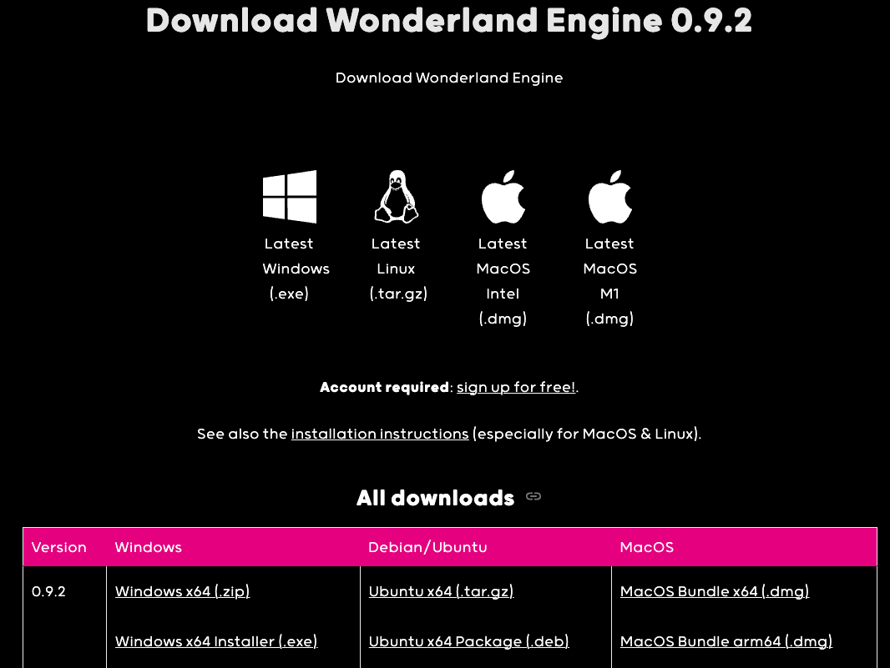

Download and install
Create an account - https://wonderlandengine.com/account/
Download Wonderland Engine from the website - https://wonderlandengine.com/downloads/
Notes:
Before we can begin creating a new Wonderland project, please use the QR code or URL to create an account, download and install Wonderland Engine.

Slide 6
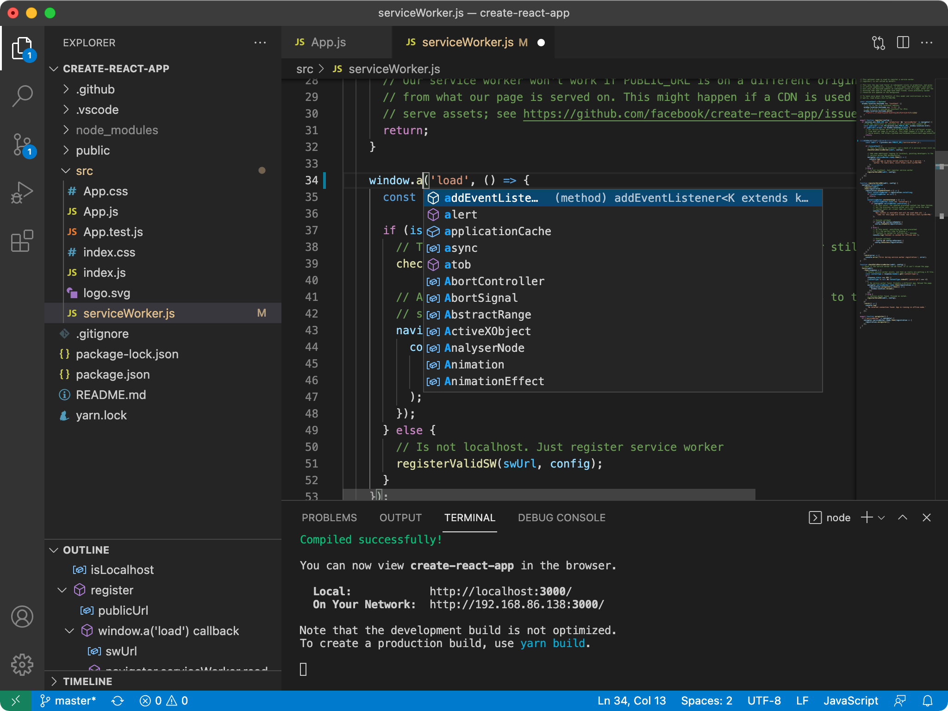

Install a code editor – Visual Studio Code
Wonderland Editor cannot edit JavaScript files. An external code editor is required. Visual Studio Code is recommended.
Download Visual Studio Code from the website - https://code.visualstudio.com/
Notes:
The Wonderland Editor is only for making changes to the 3D environment. A separate code editor is needed to edit the JavaScript files, and we recommend using Visual Studio Code for this, you can follow the QRCode or URL to download it.

Slide 7
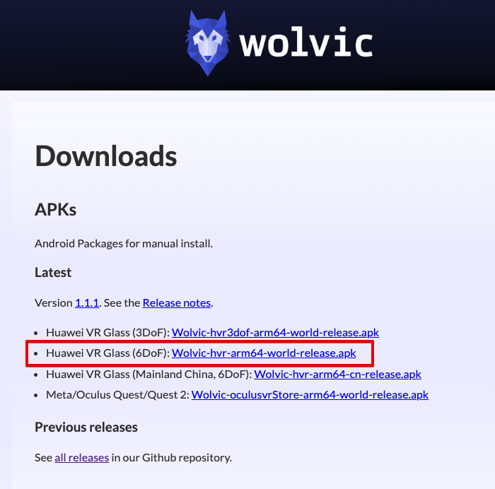

Install Huawei VR Glass Browser – Wolvic
Download and install Wolvic VR Browser 6DoF (Wolvic-hvr-arm64-world-release.apk) - https://wolvic.com/dl
Notes:
In addition to a code editor, you’re going to need a full VR Browser app to run the game on your Huawei phone. The Wolvic VR Browser is the only VR-capable browser created for the Huawei VR Glass. Please download Wolvic VR Browser 6DoF version from wolvic.com/dl.
Before moving onto the next step, let me introduce you to Bryant, and he will explain the code development.

Slide 8
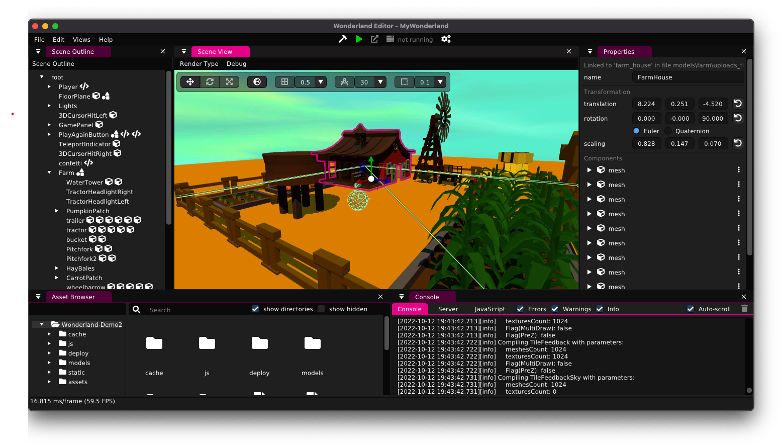
Wonderland Engine overview
Package the entire project into deployable files
Package, start server, open browser
Open Browser
Start/stop server
Scene Outline
View, manage the scene, object hierarchy, etc.
Properties
Scene View
Console, Server, Javascript panel
View the logs here for debugging
Asset Browser
Drag-n-drop assets into Scene
Notes:
Hello everyone, I’m Bryant from Futurewei Technologies.
Here’s what the layout of the Wonderland Editor looks like, which is similar to a streamlined 3D model editor.
The Scene View displays a preview of the 3D environment
All objects can be viewed and managed from the Scene Outline.
The Asset Browser allows for drag-and-drop importation of assets into the project.
Individual object properties can be changed from the Properties View.
The console can be viewed from the bottom right for debugging.
You can package and start your game server from the top center of the window.

Slide 9
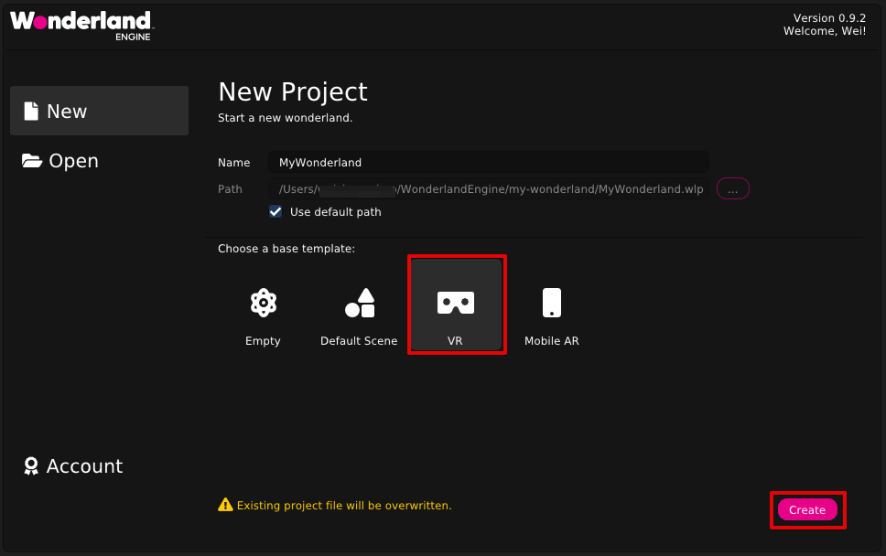
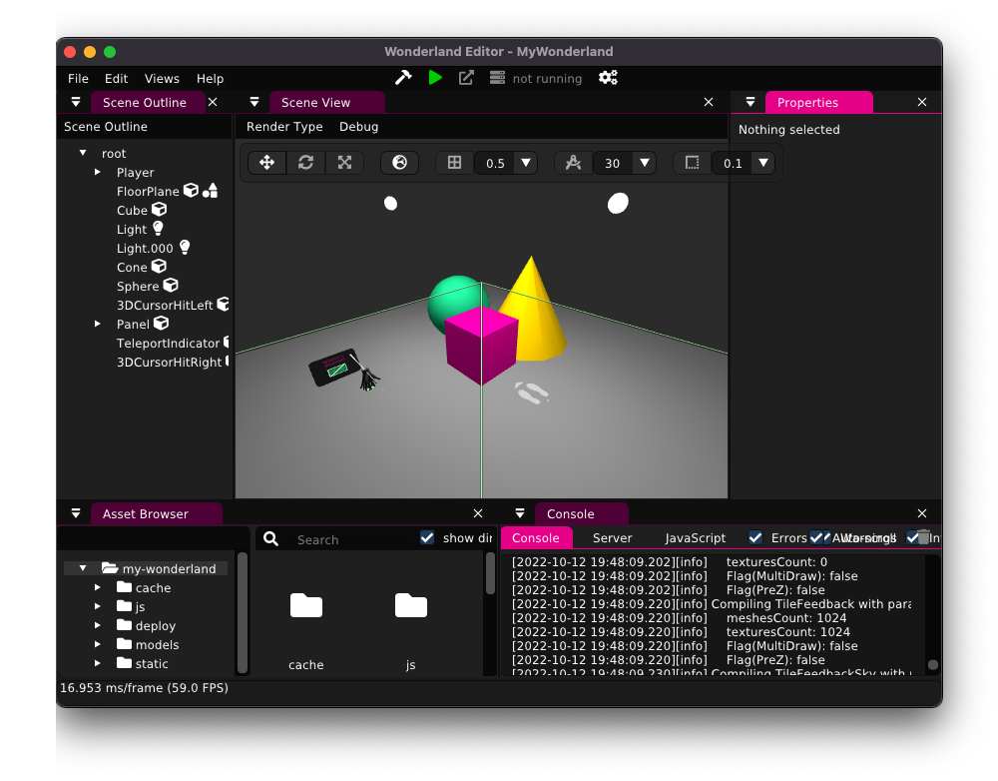
Getting started - create a new VR project
Create a New Project with VR template.
Notes:
Now that we’ve got all the tools installed and our environment setup, let’s create a new Wonderland project.
From the welcome screen select New > VR template > create to open up a new project.

Slide 10
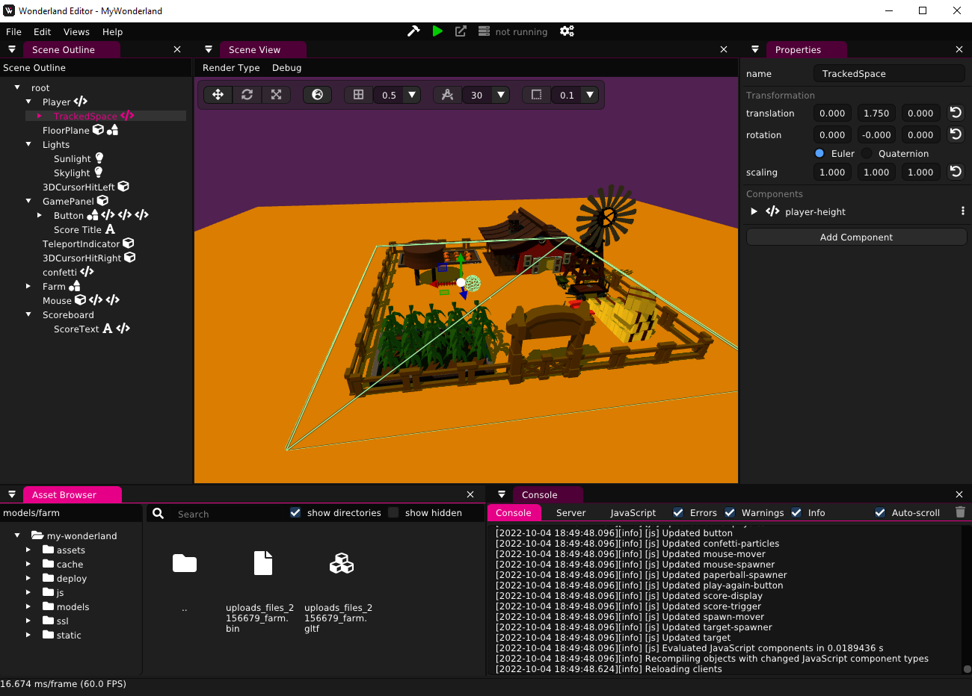
Import 3D objects into the scene
#4
From the Asset Browser, open the models folder.
Drag and drop your 3D objects from your system into the models folder.
Drag and drop your 3D objects from the models folder into the Scene View.
Your object should show up in the Scene View as well as the Scene Outline.
#3
#1
#2
Notes:
We start the project off by importing all the 3D models needed. This can be done by first dragging and dropping the files directly into the models folder of the Asset Browser and then dropping them into the Scene View.

Slide 11
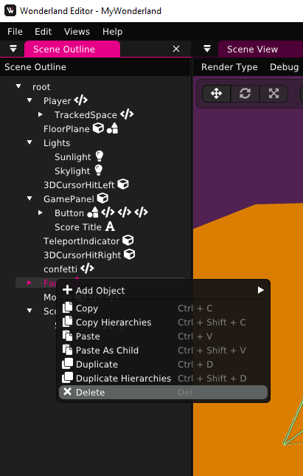
Deleting objects
To remove an object from the scene, right-click the object from the Scene Outline and select the Delete option.
Notes:
If you need to remove an object from the scene, right-click it from the Scene Outline and selecting the Delete option. It will still be available in the Asset Browser.

Slide 12
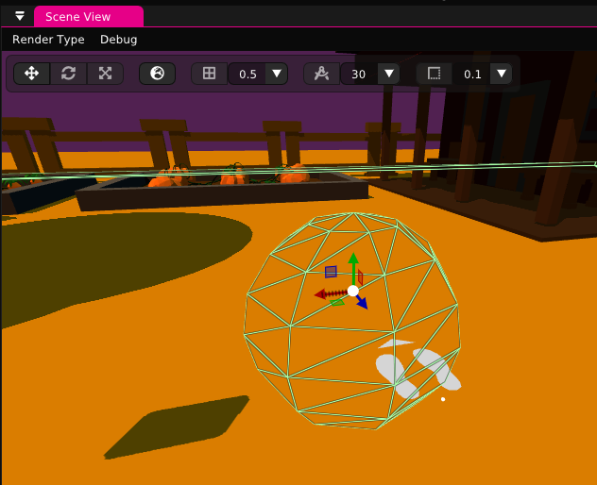
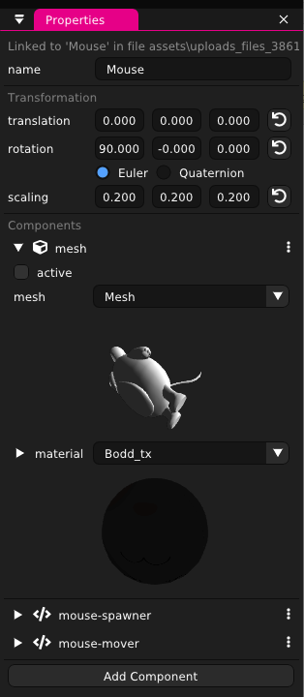
Modify objects
#1
#3
Objects can be modified directly in the Scene View - Translation, rotation, and scaling by dragging the mouse/trackpad.
Changes can also be made from the Properties view by inputting values for greater precision.
Component values can also be modified in the Properties view.
#2
#3
Notes:
Objects transformation can be done from either the Scene or Properties View. Modifications made from the Scene View are best for coarse changes while the Properties View allows for precision changes.
Additionally, the Properties View can be used to change JS component values.

Slide 13
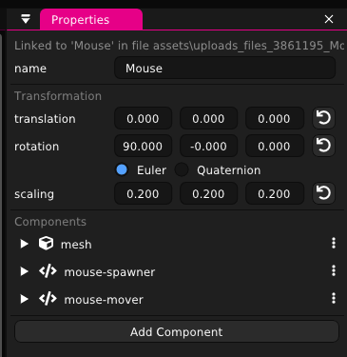
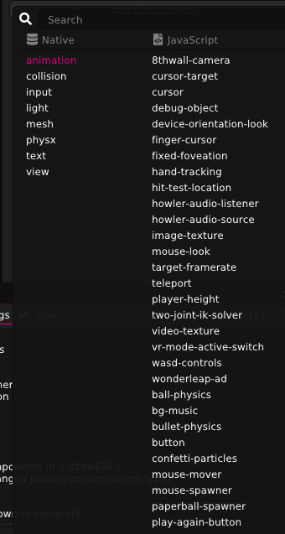
Adding JavaScript components to objects
JS components can be added to each object from the Properties view.
Some of these components come with Wonderland (ex: 8thwall-camera, howler-audio-source) and the rest are user defined (ex: mouse-mover, mouse-spawner).
Notes:
The Properties View not only allows for changing the values for JS components, but components can also be added to objects from this view as well.

Slide 14
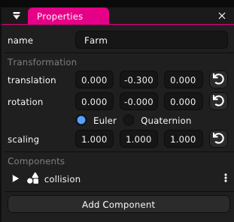
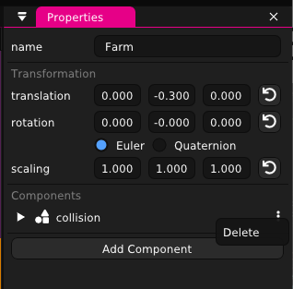
Deleting JS components
Similarly, for a JS component, click the 3-dot icon on the component (from the Properties view) and select the Delete option.
Notes:
To remove JS components from an object, click the 3-dot icon and select the Delete option.

Slide 15
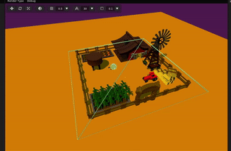
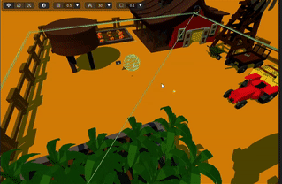
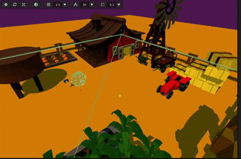
Modify scene view
Zoom using the scroll wheel
Pan by right-clicking and dragging
Rotate by holding the middle-mouse button and dragging.
#1. Zoom
#2. Pan
#3. Rotate
Notes:
To change the camera view of the scene, we can zoom using the scroll wheel, pan by right-clicking and dragging, or rotate by holding the middle-mouse button and dragging.

Slide 16
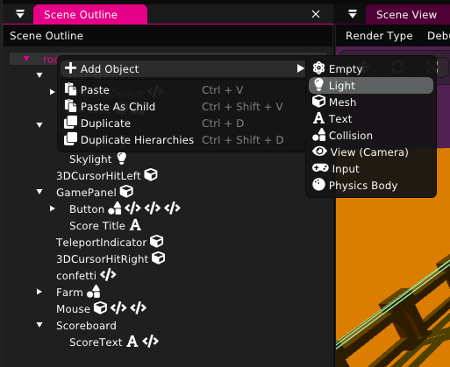
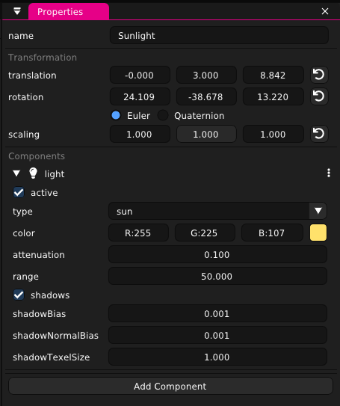
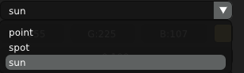
Lighting
From the Scene Outline, right-click root > Add Object > Light to create a new Light object.
In the Properties view, you can adjust the transformation, light intensity, color, and light type.
Expanding the type drop-down menu shows 3 different light types. Single sun light can illuminate the entire scene in comparison to multiple point lights while having better performance.
#1
#2
#3
Notes:
To add a new light object, navigate to Scene Outline > right-click root > Add Object > Light. With a light object, we can change its transformation, light intensity, color, and light type in the Properties View. There are 3 different light types available: point, spot, and sun. Each option has different advantages and disadvantages depending on the desired use-case. If you want to illuminate the entire scene, it’s best for performance to use a single sunlight instead of multiple point lights.

Slide 17
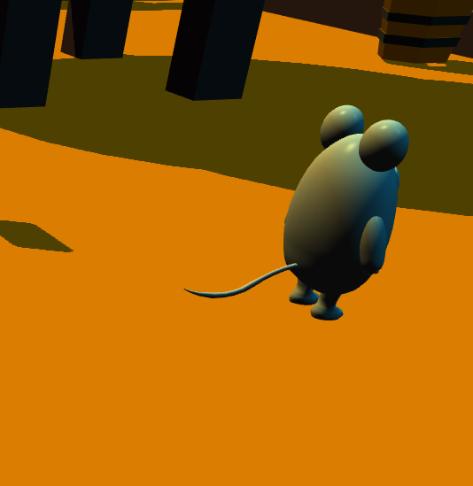
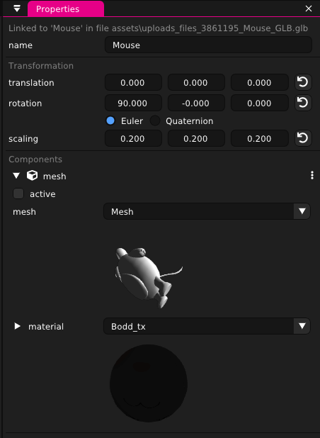
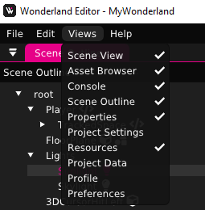
Enabling shadows
Some objects may not cast shadows.
Navigate to the Properties view of the object and check the material selection (under Components > mesh > material)
From the top left, open Views > Resources.
#1
#3
#2
Notes:
Some objects in the scene might not cast shadows as expected. To fix this problem, navigate to the Properties View and check for the material name that your object is using. Then navigate to Views > Resources from the top left of the window.

Slide 18
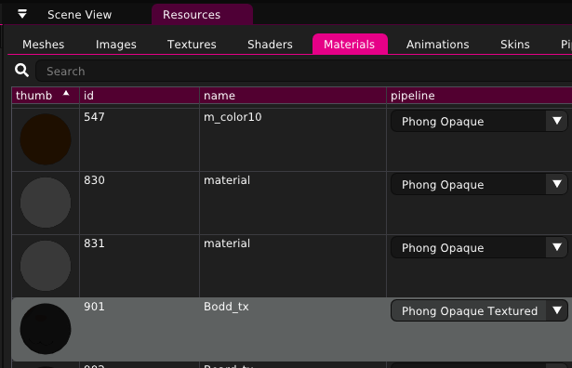
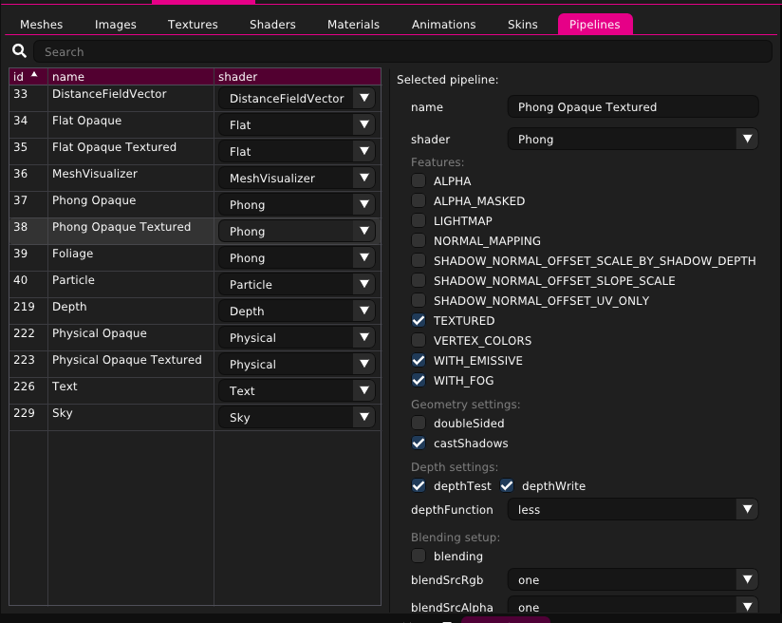
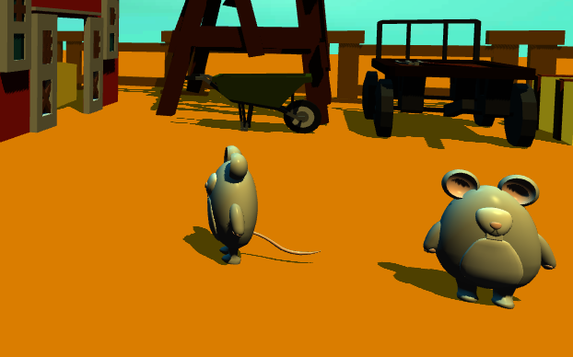
Enabling shadows (cont.)
#4
#1
#2
Check which pipeline correlates to the material of your 3D object.
Switch to the Pipelines tab (Views > Resources > Pipelines) and select your pipeline.
Enable Geometry settings > castShadows
Disable Features > ALPHA and ALPHA_MASKED
#3
Notes:
Since we know the material name, check which pipeline correlates to the material of your 3D object. Finally go to the Pipelines Tab, select your pipeline, enable castShadows, and disable both the ALPHA + ALPHA_MASKED settings. This should enable casted shadows for your object.

Slide 19
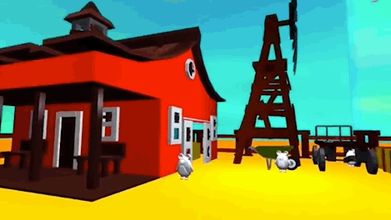
Game objective and design
The design goal was to create an engaging and dynamic game as a showcase for VR. We chose to make a shooter as it best fits these requirements.
Our game takes place on a farm that has become overridden with mice. The objective of the game is to do some pest control and save the farm! The player is tasked with shooting all the mice as they appear to win the game.
Aside from all the 3D assets that need to be imported, we have to add in JS to define how all the objects interact with each other and build the game logic.
Notes:
Now that we have all the basics of the Wonderland Editor down, we’re going to move into the details of our game demo.
The design goal for our game was to create an engaging and dynamic experience as a showcase for VR. We decided to make a shooter game as it best fits these requirements.
The game takes place on a farm that has become overrun with mice. The objective of the game is to do some pest control and save the farm! The player is tasked with moving around the farm and shoot all the mice to win the game.
Aside from all the 3D assets that need to be imported, we also have to add in JavaScript to define how all the objects interact with each other and build the game logic.

Slide 20
JavaScript game components
Target-spawner: Invisible object that moves around the map and spawns mice at set intervals.
Targets: Mice are randomly spawned in close proximity to the last mouse spawned in using the target-spawner object.
Bullet-spawner: Spawns bullets and attaches bullet-physics to each one.
Bullet-physics: Controls bullet trajectory.
Collision: The mice and bullet need collision configured to detect when they are hit by each other.
Score-trigger: Attached to each bullet and updates score if mouse is hit.
Audio: Plays SFX and music.
Notes:
Let’s dive into the various JavaScript components that our game uses.
We have an invisible target-spawner object moves around randomly and spawns the mice at set intervals.
The mice are randomly spawned in nearby to the last mouse spawned based on the behavior of the target-spawner object.
The player is able to shoot the mice because of the bullet-spawner component which spawns bullet objects and attaches bullet-physics to each one.
The bullet-physics component controls the trajectory of the bullet and its lifecycle.
Both the mice and the bullets have collision components configured to detect when they are hit by each other.
Each bullet also has a score-trigger component which listens for a collision event with a mouse and triggers a score event.
Additionally we use audio to play sound effects and music.

Slide 21
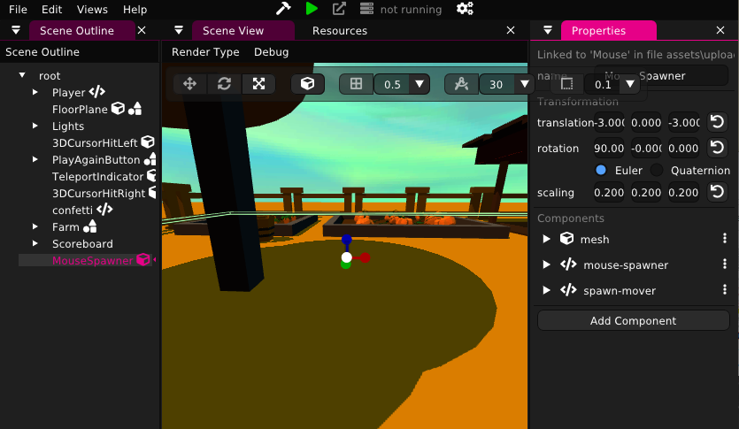
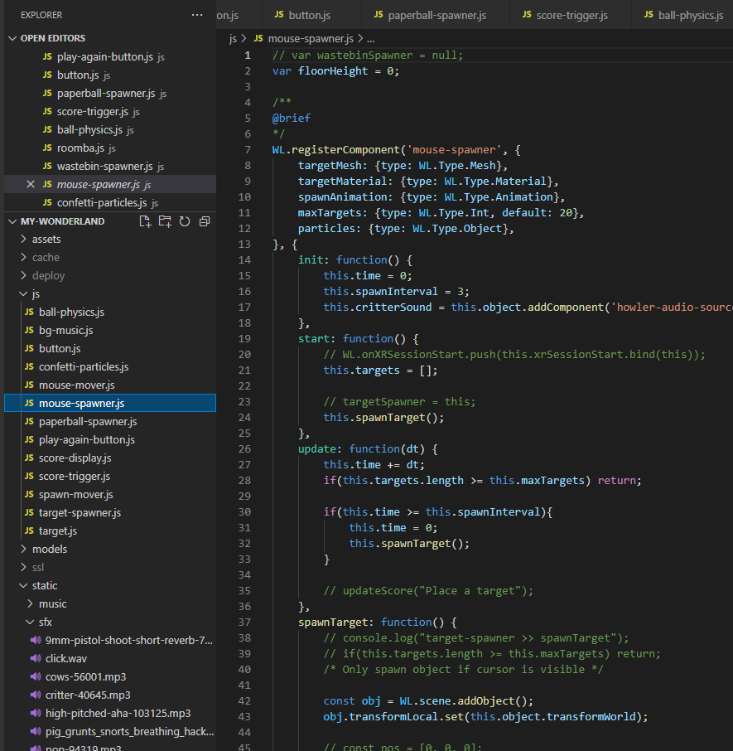
Apply JavaScript logic to the scene
Use code editor like Visual Studio Code to add JavaScript components and define the behavior of individual objects, such as movement, object spawning, adding/removing components, collision effects, etc.
Notes:
To apply JavaScript to our Wonderland project, we need to use a separate code editor like Visual Studio Code to make the actual code changes. The JavaScript defines the behavior of individual objects, such as movement, object spawning, adding or removing components, collision effects, etc.

Slide 22
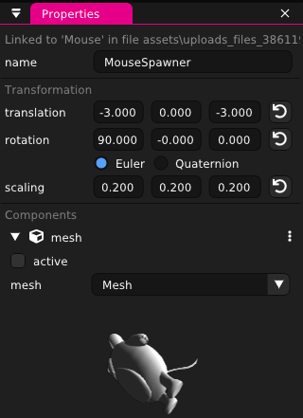
JavaScript – Mouse Spawner
The Mouse object in the scene is an invisible object that spawns the actual in-game mice that the player shoots at. You can see that the mesh object is not active, rendering it invisible.
Other than the inactive mesh component, there are two JS components that control how the mice are spawned and how the spawner itself moves around the map: mouse-spawner and spawn-mover.
Notes:
Here we have the Mouse Spawner object. Instead of having all the mice spawn in at the same time, we wanted the spawn locations to be a little bit more random and more fun to the player.
Because this is just the Mouse Spawner and not the actual mice targets that the player shoots, we don’t want the player to see where this object is. As you can see from the both Scene and Properties View, the Mouse Spawner is rendered invisible because the mesh component is set inactive.
Other than the inactive mesh that affects how the object looks in the game, there are two components for its behavior. These components control how the mice are spawned and how the spawner itself moves around the map: mouse-spawner and spawn-mover.

Slide 23
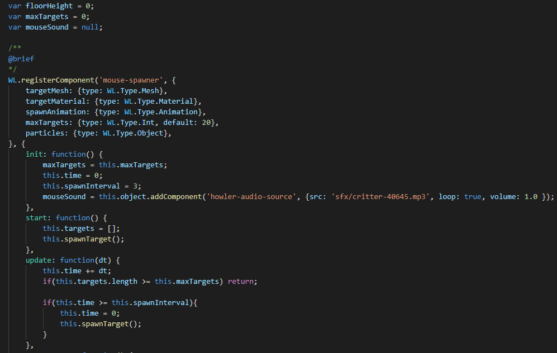
JavaScript – Mouse Spawner (cont.)
#1
Global variables that can be accessed by other JS files.
Variables declared here can be accessed and changed from the Properties View in Wonderland Editor
Init() is the first function that is called. We set some vars here and initialize the mouse sound effect.
Start() is always called after Init() has completed. Here we call spawnTarget().
The update() function is called at every frame update. The mice are spawned at set time intervals with a maximum number of mice that can be spawned.
#2
#3
#4
#5
Notes:
Now we’ll take a look at the JavaScript files for the Mouse Spawner object. Here we have the actual code for the mouse-spawner component.
At the top of the file, we define the global variables that can be accessed by all the other JS files. This can be quite useful, but not recommended for all variables you might use in your project.
Right after the component name declaration, we can define variables here with values that can be changed from the Properties View in the Wonderland Editor. This type of variable declaration is most useful for mesh, material, and animation options.
Init() is the first function called in the component lifecycle. We initialize the rest of the variables here and also initialize the mouse sound effect.
Start() is always called after the init() function has completed. Whether or not you decide to use the start() function is up to you. Here we make the first call to the spawnTarget() function which spawns the first mouse at the beginning of the game.
The update() function is called for every frame update. For example, 60 frames per second means that update() is called 60 times per second. In general, it makes sense to update the position of moving objects, listen for collision events, time-sensitive events, and put anything that relies on time here. For the mouse-spawner, we check the time elapsed and spawn the mice at set intervals until the maximum number of mice is reached.

Slide 24
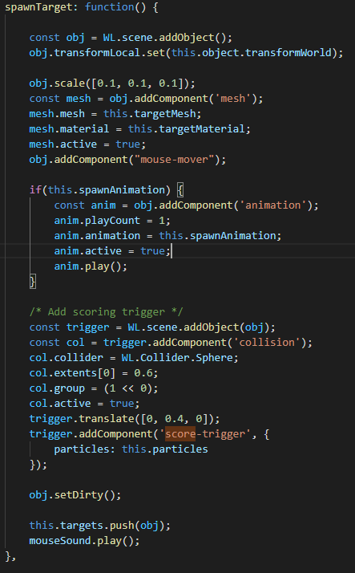
JavaScript – Mouse Spawner (cont.)
First we add a new object using WL.scene.addObject(), set it’s position relative to the mouse-spawner object, and set the scale.
Next we add the mesh component and add the mouse-mover JS component (the same one that the mouse-spawner uses) to define it’s movement behavior.
Here we create another object on top of the mouse and add the collision and score-trigger. The collision component allow us to know if the mouse gets shot by the player. Score-trigger updates the score and triggers the confetti when the mouse is shot.
Lastly, we play the mouse sound effect when it spawns in.
#1
#2
#3
#4
Notes:
In the spawnTarget() function we create a new object, set it’s position relative to the current spawner location, and set its size. Then we add the mesh, spawn-mover, collision, and score-trigger components. For a final touch, we play the mouse sound effect as a cue to the player that a new mouse has spawned in.

Slide 25
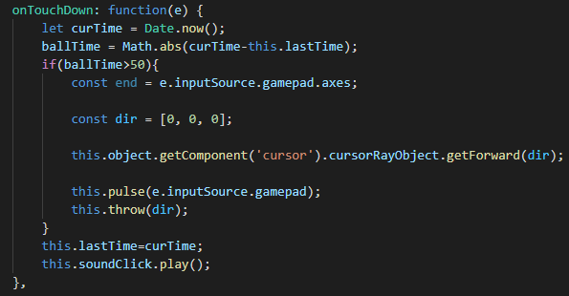
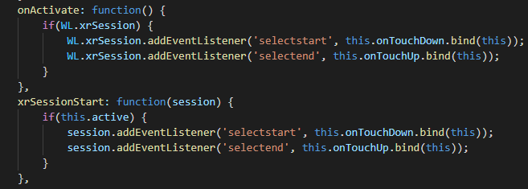
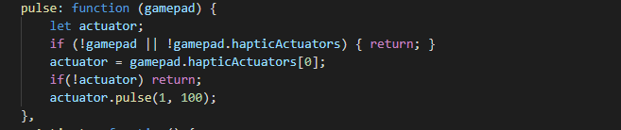
JavaScript – Bullet Spawner
#1
onTouchDown() is called when the controller trigger is pressed down. First we check if enough time has elapsed since the last time a projectile was spawned to limit the rounds per minute the player can shoot. Then we get the forward vector of the cursorRayObject that the bullet-spawner component is attached to get the direction we shoot in and plug that into the throw() function.
onActivate() and xrSessionStart() are used to bind the selectstart event to onTouchDown
Pulse() vibrates the controller for better player haptics.
#2
#3
Notes:
The bullet-spawner component is attached to the controller and listens for input from the trigger and acts as the fire control for new bullet objects. Moving forward, we’re just going to focus on the more significant portions of the code.
onTouchDown() is called when the controller trigger is depressed. The onActivate() and xrSessionStart() functions are used to bind the selectstart events to onTouchDown() before everything else loads.
To control the player’s rate of fire, we do a check for the time since the last shot occurred. If enough time has passed, we get the forward vector of the controller’s cursor to determine the direction that the bullet should travel in and pass it into the launch() function.
To provide better haptic feedback to the player, pulse() is used to vibrate the controller on every shot.

Slide 26
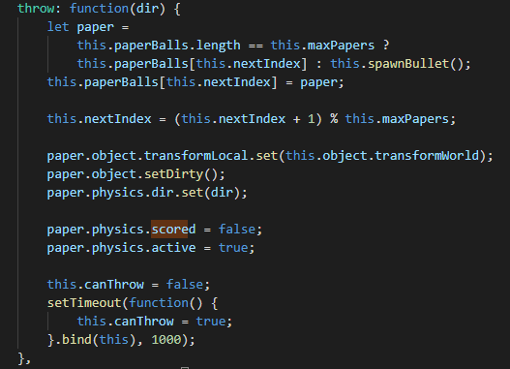
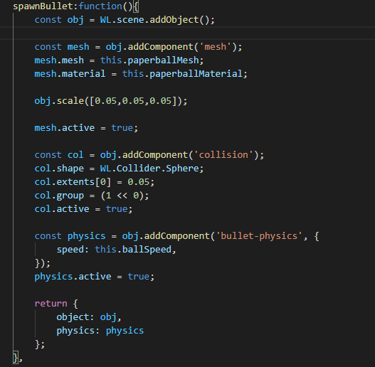
JavaScript – Bullet Spawner (cont.)
#1
launch() does a few checks before calling spawnBullet()
spawnBullet() adds a new object and applies the scaling as well as mesh, collision, and bullet-physics components.
#2
Notes:
Launch() does a few checks before calling spawnBullet().
spawnBullet() adds a new object for the bullet, sizes it to the correct scale, and adds the mesh, collision, and bullet-physics components.

Slide 27
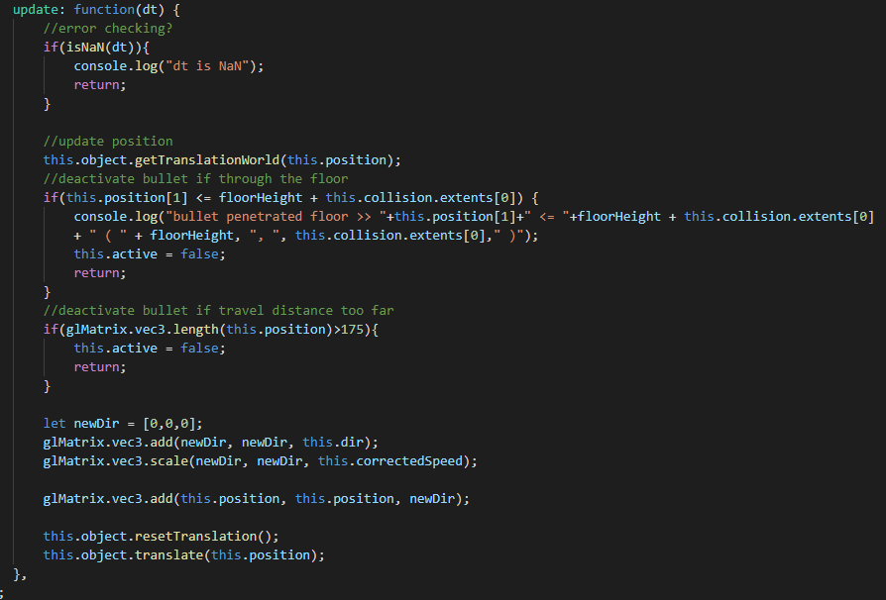
JavaScript – Bullet trajectory control
#1
Most of the work in bullet-physics is done in the update() function since we expect the ball to be constant motion.
If the bullet hits the floor, we deactivate the object to preserve performance.
If the bullet travels too far from the player (beyond what they can see) we also deactivate it.
Otherwise the bullet continues traveling on a linear path from its point of origin at a constant speed.
#2
#3
#4
Notes:
Control of the bullet trajectory is done in just a few lines in bullet-physics. Most of the work in bullet-physics is done in the update() function since we expect the ball to be in constant motion.
If the bullet hit the floor, we deactivate the object to preserve performance.
If the bullet travels too far from the player beyond the load distance, we also deactivate it.
Otherwise, the bullet continues traveling on a straight path from where it was shot at a constant speed.

Slide 28
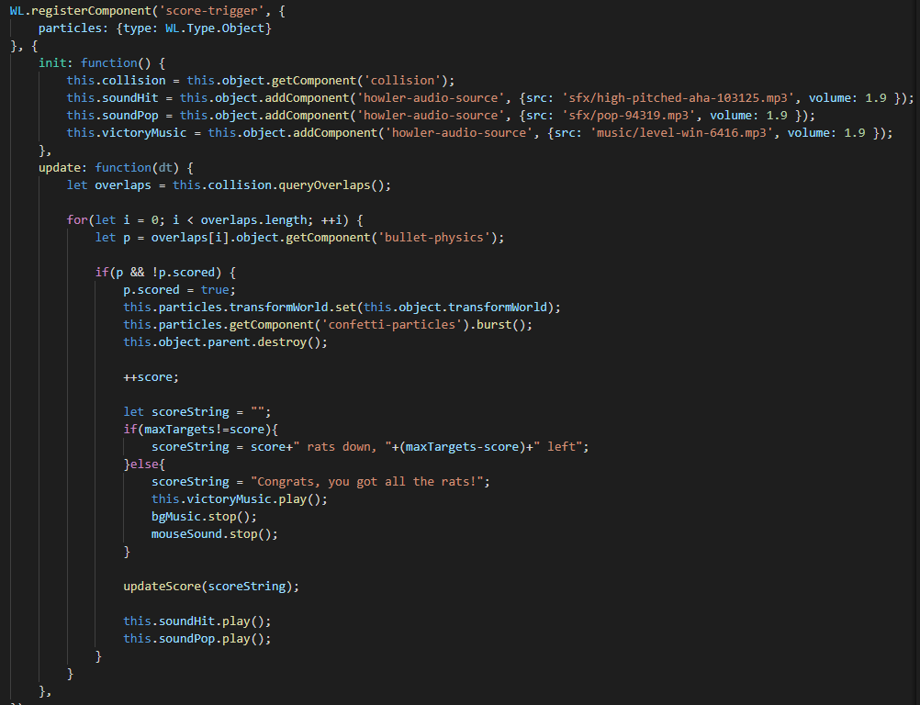
JavaScript – Collision detection and scoring
#1
The score-trigger component is attached to every single mouse and will trigger when the bullet hits its collision component.
We initialize the SFX audio here, but don’t play it yet.
We want the score-trigger to check for collisions as much as possible, so it’s done here in the update() function.
If a collision overlap is detected we trigger the confetti particles, destroy the mouse object, update the score message, and play a hit SFX. If all the mice have been eliminated, the score message changes accordingly, the background music and mouse SFX stops, and the win music plays.
#2
#3
#4
Notes:
Each bullet has a score-trigger component attached to it which detects if it has collided with a mouse while the bullet is still active.
Inside of init(), we load the audio sound effects and play them later.
We want the score trigger to check for collisions whenever the bullet updates its position, therefore we also do the checks for score-trigger inside of update().
If a collision is detected we trigger the confetti particles, destroy the mouse object, update the score message, and play a hit sound effect.
If all the mice have been eliminated, the score message changes to show a win, the background music and mouse sound effects stop, and the win music plays.

Slide 29
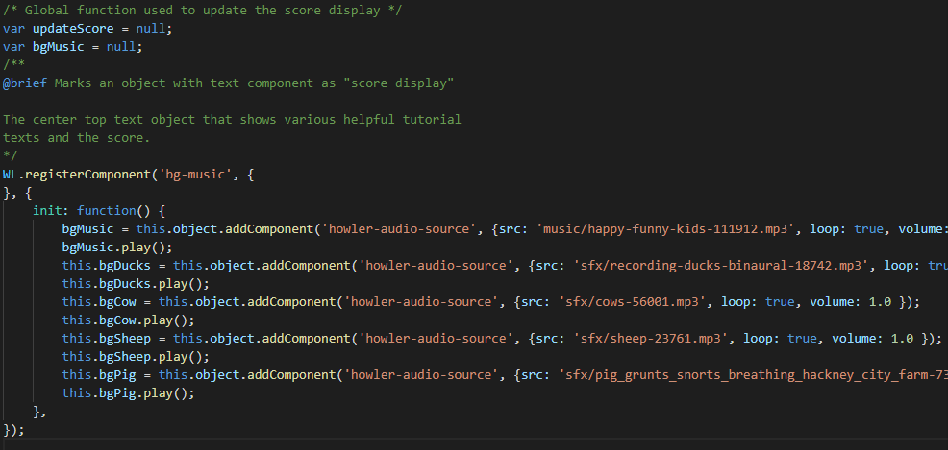
JavaScript – SFX, music
All the background SFX and music is done in bg-music which is attached to the player object.
Initializing and playing sounds is quite simple.
If other JS components need to access this audio, it just needs to be declared as a global var.
Notes:
All the background sound effects and music are implemented in bg-music which is attached to the player object. This means that the audio volume from these sources stays constant no matter where the player moves.
As you can see, initializing and playing sounds is quite simple and takes only 2 lines of code per audio source.
If other JS components need access to this audio, it just need to be declared as a global variable instead of a local one.
With that, we have covered the code development.

Slide 30
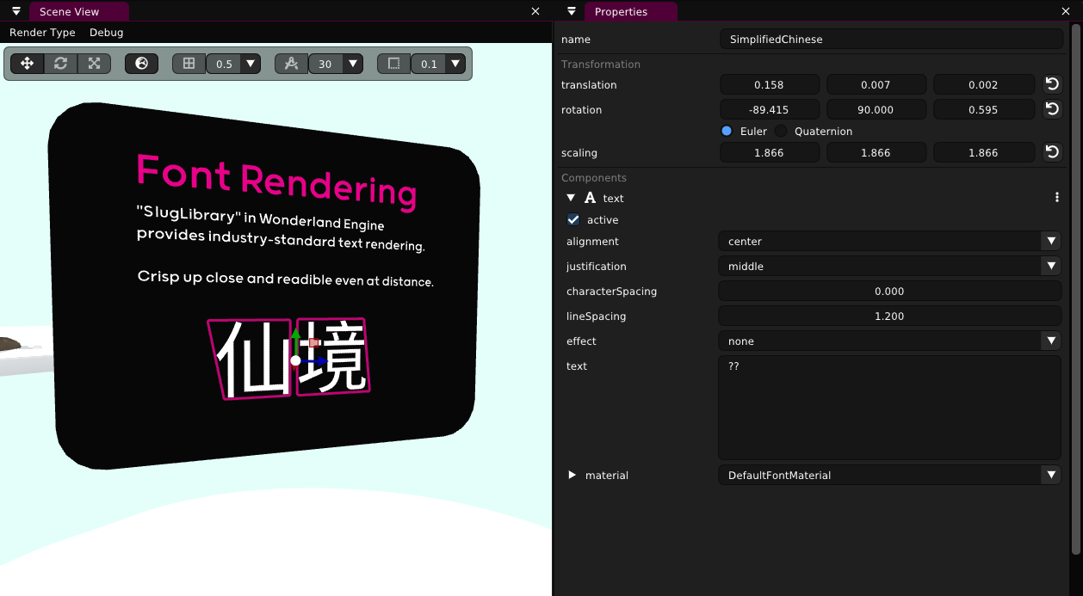

Rendering Simplified Chinese characters
You can incorporate Simplified Chinese fonts into your project by following the tutorial here - https://wonderlandengine.com/tutorials/rendering-simplified-chinese-characters/
Notes:
Thanks Bryant! Before we wrap up this video, let’s look at some extra features and debug.
The Wonderland Engine supports rendering of simplified Chinese characters. You can incorporate Simplified Chinese fonts into your project by following the tutorial found on the Wonderland Engine website.

Slide 31
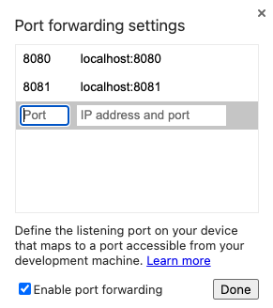
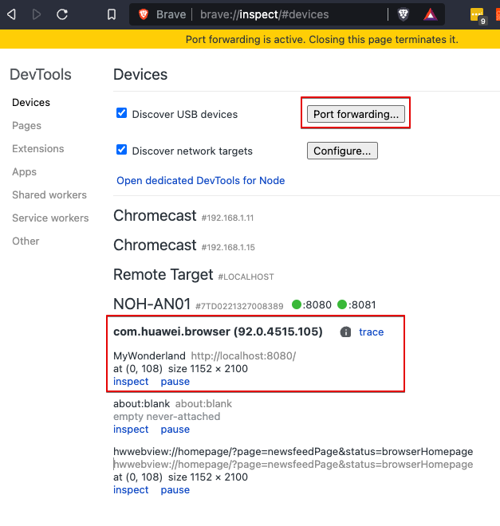
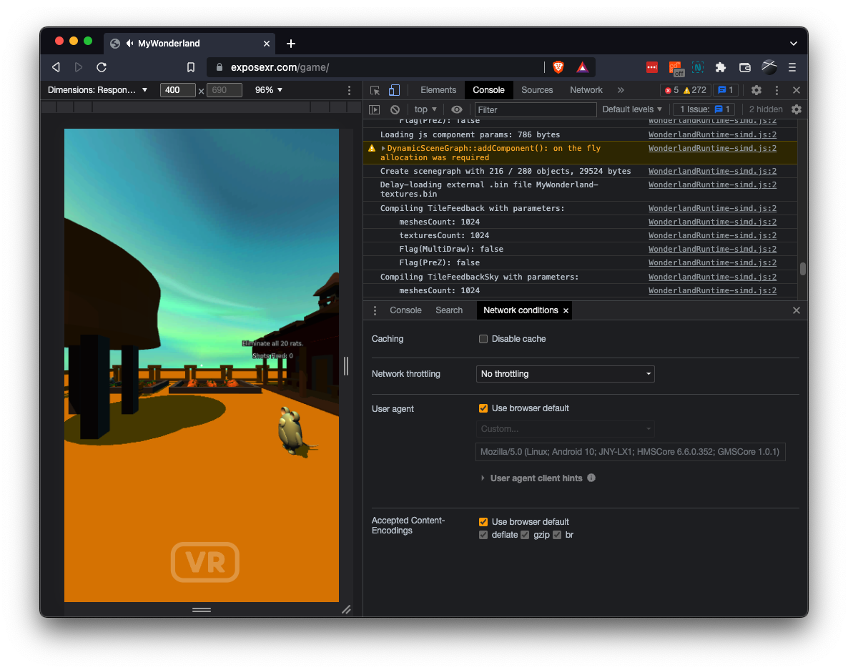
View and debug in Huawei VR Glass
Enable USB debugging on Huawei VR compatible Huawei phone.
Enable ADB over Wi-Fi and connect to Huawei phone.
Generate SSL key, certificate, and DH parameter files.
Wonderland Engine - navigate to Views > Preferences > Server, enable SSL server and enter the SSL files.
Repackage Wonderland project and launch the server.
Go to desktop Chrome browser, enter URL chrome://inspect#devices, click Port Forwarding button, add Port: 8081, IP address and port: localhost:8081. Check Enable port forwarding and click Done.
Put on Huawei VR Glass, launch either the Wolvic VR Browser and visit https://localhost:8081/index.html
Notes:
When using the Huawei VR Glass, it is not possible to connect the phone via USB and debug the Wonderland game while it’s running on the device. This is because there is no available USB port on the phone, as it is taken up by the VR Glass.
Instead, we have to use ADB over Wi-Fi to connect to the Huawei phone. This can be done by enabling ADB over Wi-Fi on the Huawei phone, configuring the SSL server on the Wonderland Editor, and using localhost port 8081 instead of localhost port 8080 to connect to the Wonderland local server. You can follow the guide to set up your development environment.

Slide 32
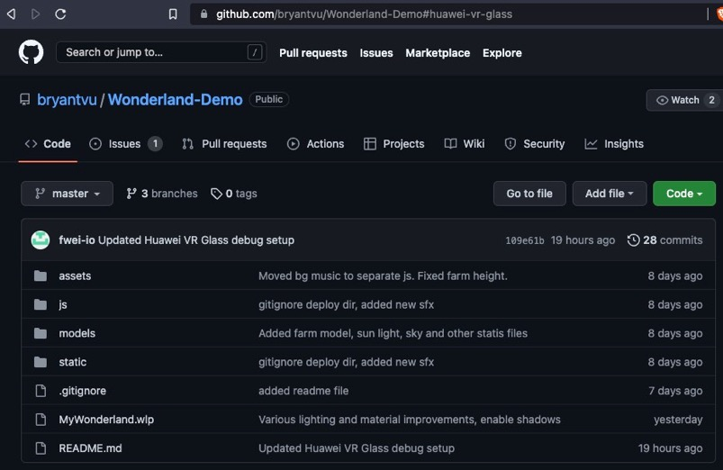

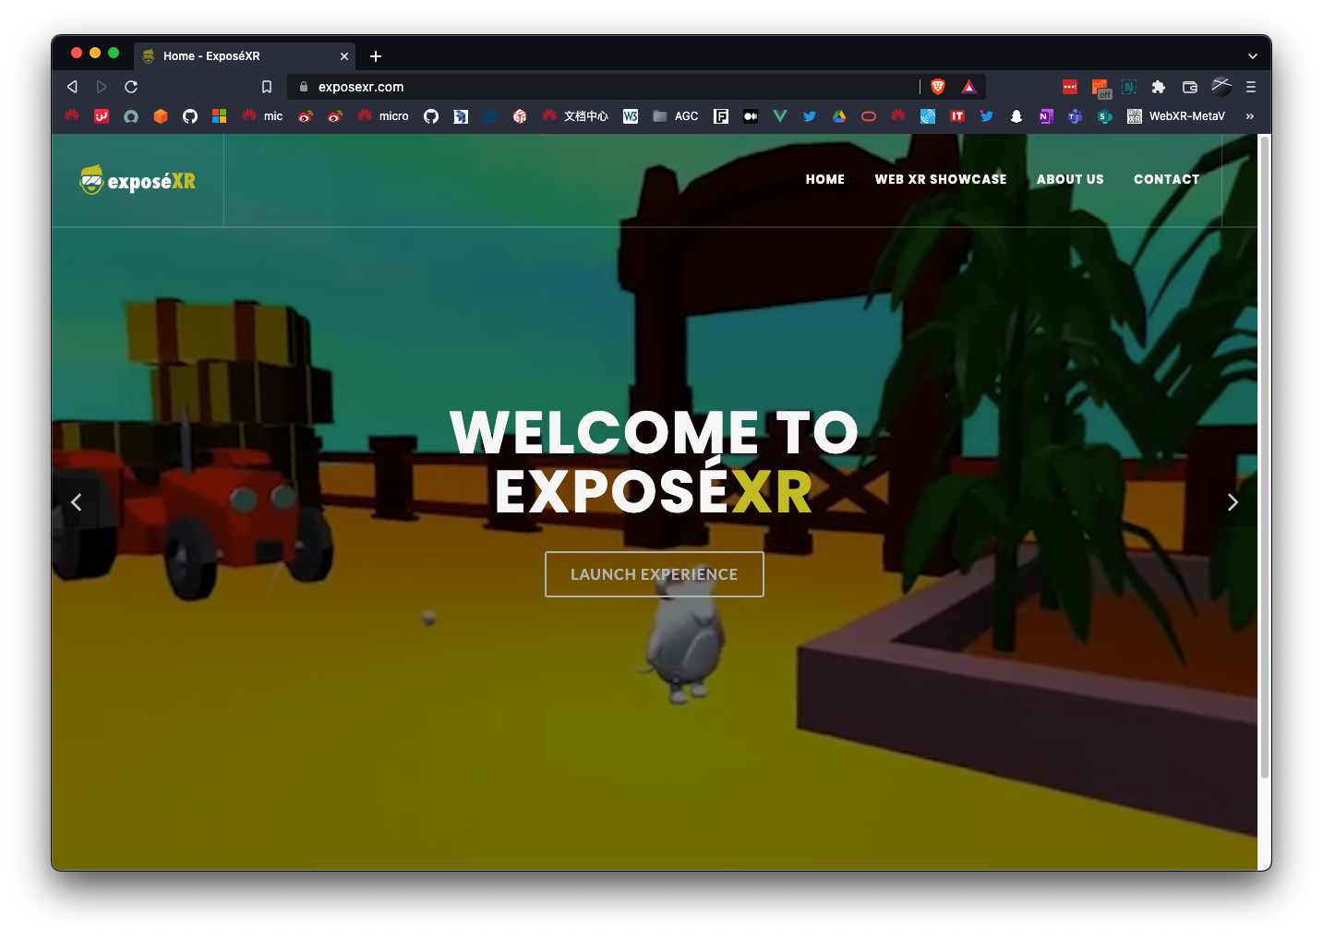


Demo code, download & websites
https://github.com/hms-ecosystem/Wonderland-Demo
https://wonderlandengine.com/downloads/
https://wolvic.com/dl
https://exposexr.com/zh
Notes:
That concludes our presentation on the Wonderland Engine demo. Here are the links for the free and complete game source code, the Wonderland Engine itself, the Wolvic VR Browser, and the our website running a live instance of the game. Thank you!

Slide 33
Thank You
Wei Chung Chuo
Lead Developer Technical Engineering Solution
Futurewei Technologies, Inc.

